Slide 1
USSEC Global Strategy Session
Thomas Hammer, President
National Oilseed Processors Association
San Antonio, Texas
January 21, 2015

Slide 2
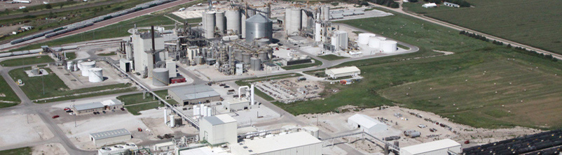
NOPA Members
13 NOPA member companies
Account for 95% of U.S. soybean crush
Operate 63 processing plants in 19 states, including 57 that process soybeans
Crush 1.645 billion bushels, comprising almost 52% of U.S. soybean farmers’ production in 2013/14

Slide 3
NOPA Membership
Ag Processing Inc.
Archer Daniels Midland Company
Bunge North America
Cargill, Incorporated
CHS
Consolidated Grain and Barge Company
Incobrasa Industries, Ltd.
Louis Dreyfus Commodities
Northstar Agri Industries
Owensboro Grain Company
Perdue Grain & Oilseed, LLC
Riceland Foods, Inc.
Zeeland Farm Soya

Slide 4
Can U.S. Crushers Export more Soybean Meal?
U.S. processors investing in their crush plants to increase efficiency and capacity
NOPA monthly crush & export numbers are at record levels
Volume of U.S. soymeal exports is now 30% of total production – up steadily over the past decade
Steady growth in U.S. meat & poultry exports provides steady growth of soymeal disappearance
With this year’s larger soybean production (and other crops) - the transport system is functioning
U.S. soybean crushers can & will export more soymeal – as long as the domestic soybean crop continues to expand through the use of enhanced technology and improved farming practices & protein levels remain competitive!

Slide 5
NOPA Soybean Crush
CY2011-2014 (000Bu.)

Slide 6
NOPA Soybean Meal Exports
CY2011- 2014 (tons)

Slide 7
U.S. Soymeal Exports As Share of Soymeal Production [2000/01 – 2014/15]
Source: John C. Baize & Associates

Slide 8
Top 10 Destinations for US Soy Meal
JAN –DEC 2013 (Value/Quantities in thousands)
Country | Rank | Value ($) | Quantity (M/T)
Mexico | 1 | $ 672,494 | 1,269,452
Philippines | 2 | 605,118 | 1,120,642
Canada | 3 | 450,645 | 895,096
Venezuela | 4 | 395,482 | 755,097
Turkey | 5 | 218,243 | 397,787
Poland | 6 | 211,594 | 408,512
Vietnam | 7 | 201,226 | 377,450
Ecuador | 8 | 183,807 | 366,468
Egypt | 9 | 178,781 | 328,499
Dominican Republic | 10 | 174,236 | 331,602
Grand Total (all countries) |  | $5,423,942 | 10,160,713
Source: USDA/FAS

Slide 9
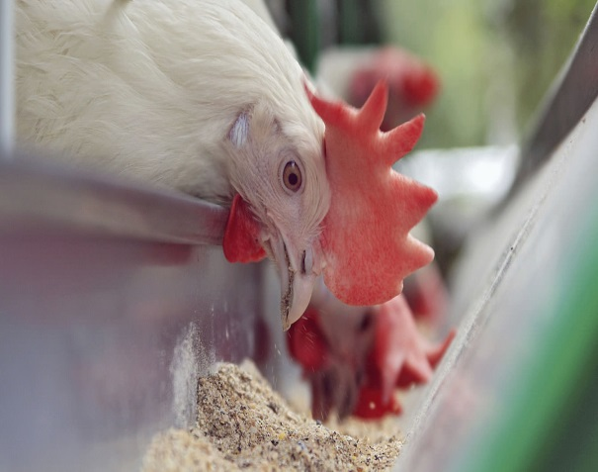
U.S. Red Meat & Poultry Exports = Steady Growth for Soymeal Usage
Source: USDA Long-term Projections, February 2014

Slide 10
U.S. Broiler Meat Exports As Share of Broiler Meat Production (2000 – 2014)
Source: John C. Baize Associates

Slide 11
U.S. Pork Exports As Share of Pork Production
(2000 – 2014)
Source: John C. Baize Associates

Slide 12
Domestic Constraints to Exporting more U.S. Soybean Meal?
Continuing need for greater supply of domestic soybeans
Improving protein levels for domestic soybeans
Increasing struggle for acres between soybeans & corn
Making critical investments in U.S. transportation systems
Terminating work stoppages at U.S. port facilities
Ending unnecessary/costly Federal & State environmental & safety/health regulations on U.S. processors and farmers
Combating anti-GMO Federal & State legislation
Maintaining market-oriented farm programs
Overcoming anti-trade sentiment from far Left & Right

Slide 13
Global Constraints to Exporting more U.S. Soybean Meal?
Increased competition/production – South America, India, etc.
Increased competition from mid-level proteins: DDGs, canola, etc.
Negative effect of the stronger U.S. dollar on exports
Slowdown in economic growth rates in key markets
Anti-competitive trade policies: DETs, GMO-labeling
Lack of synchronous approvals and low level presence (LLP) policy for biotech crops in major foreign markets
Not concluding regional free trade agreements: TTP, TTIP
Breakdown of World Trade Organization (WT0): Doha

Slide 14
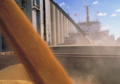
U.S. Soymeal is Very Competitive
Best farm-to-market system in world
Best farm crop management
Best delivery system
Best risk management programs
Diverse growing areas
Overall quality of the soybean is world-class
Adding Value for our Global Customers

Slide 15
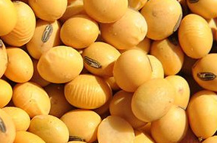
U.S. Soybeans are Unequaled
U.S. soybeans are the most sustainable in the world.
U.S. laws & regulations governing farmers, grain handlers, processors & exporters are the most rigorous in the world.
U.S. soybean meal is the best overall value in the world.

Slide 16

Top Ten Reasons to Buy U.S. Soy Meal
Nutritional Advantages
Availability of Supply
Reliability of Product
Consistency of Product
Quality/Claims Process
Quality Adjustments for Feed Ingredient Buyer
Transportation Diversity
Sustainable Production
Market-Driven Policies
USSEC Real-Time Support to Foreign Buyers with “Boots on the Ground”

Slide 17

NOPA Values its Partnership with USSEC
Thanks for allowing me to be a part of this important Global Strategy Session.
On behalf of NOPA’s soybean processing members, we value your ongoing efforts to promote the global use of U.S. soymeal.
We look forward to an even closer partnership in the future.

Slide 18
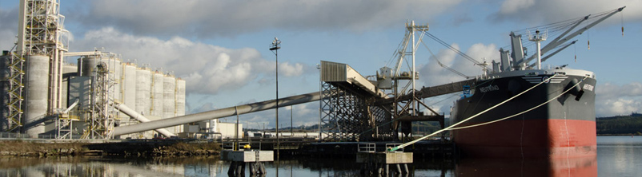
QUESTIONS & DISCUSSION

Slide 19

Contact Information:
Thomas A. Hammer, President
National Oilseed Processors Ass’n
1300 L Street, NW, Suite 1020
Washington, DC 20005
USA
Phone: 202.842.0463 ext.1
Email: thammer@nopa.org
Fax: 202.842.9126

