Slide 1
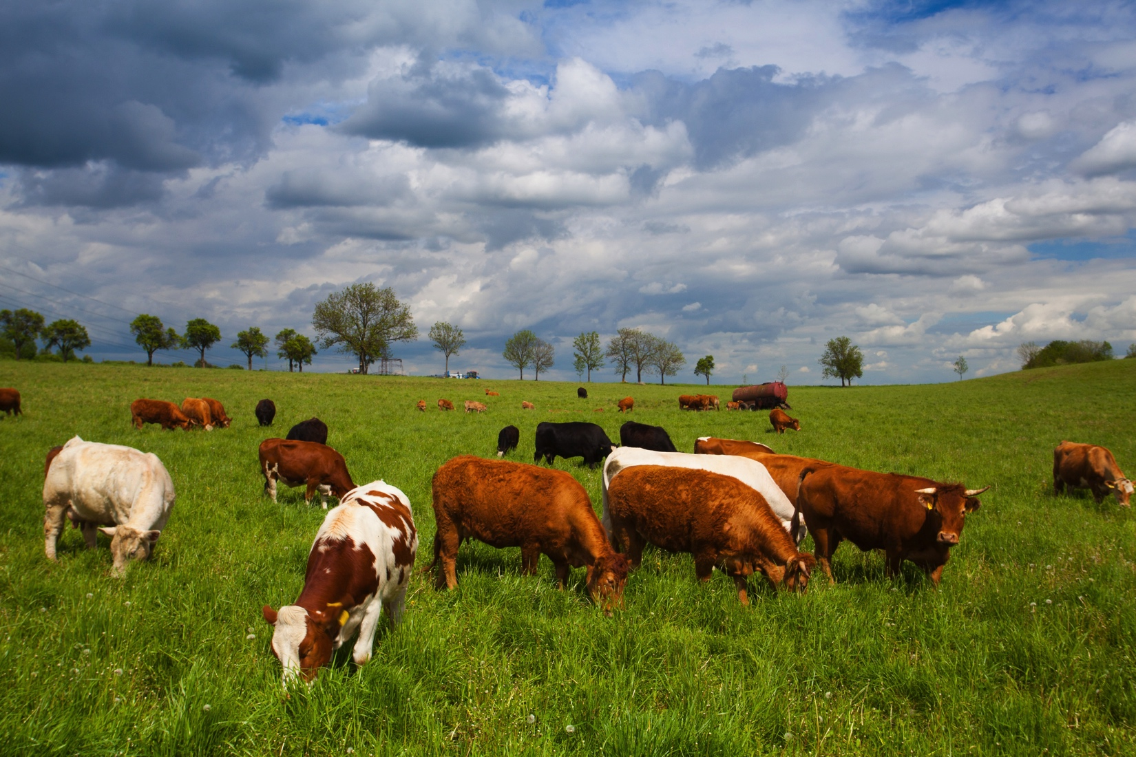
NOPA 2018
Annual Meeting:
Meat Industry Panel
Cargill Beef
Ben Brophy
February - 2018
1

Slide 2
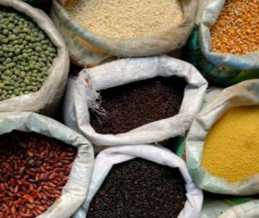
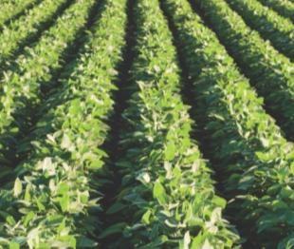


We operate within four key business segments:
Food
Agriculture
Financial
Industrial
We provide food and
beverage manufacturers,
food service companies
and retailers with
high-quality ingredients,
meat and poultry
products, and health-
promoting ingredients
and ingredient systems.
We buy, process and
distribute grain, oilseeds
and other commodities
to makers of food
and animal nutrition
products. We also
provide products and
services to crop
and livestock producers.
We provide our food,
agricultural, industrial
and financial customers
around the world with
risk management and
financial solutions.
We serve industrial
users of energy, salt,
starch and steel products.
We also develop and
market sustainable
products made from
agricultural feedstocks.

Slide 3
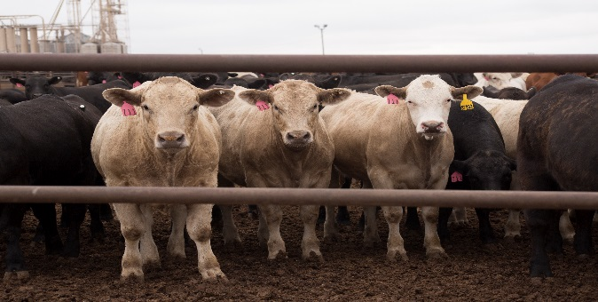
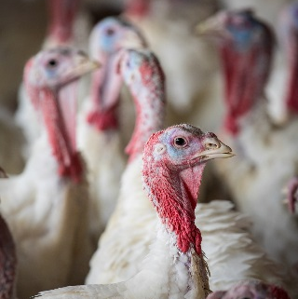
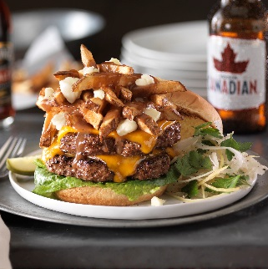
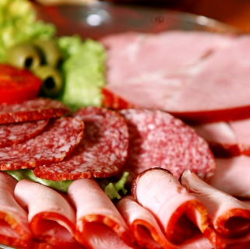

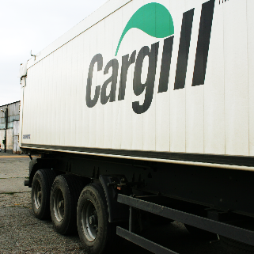
Cargill Protein’s Global Footprint
Second largest fed beef processor in North America
Largest supplier of ground beef in the world
Vertically integrated turkey business – feed mills, hatcheries and processing facilities
Largest processor of fresh, whole turkeys
Deli and cooked meats capabilities
Value-added products provided to foodservice customers
A leading chicken products provider to foodservice customers in Canada
Second largest supplier of precooked and liquid egg products in the foodservice and protein ingredients marketplaces
Food distribution centers located across the U.S.
Notes:
As one Cargill Protein team, we make a huge (and growing) impact across our industry. As one protein team, we will now operate as a united team to provide any protein solutions our customers may need. The list you see here summarizes a few key components of who we are as a single, united team.
It is incredibly exciting to think about the impact we can make in our industry. Through our new transformation strategy, our goal is to combine our skills, technologies and capabilities to provide solutions and innovative offerings that drive customers to choose us.
Additional note: We distributes Cargill protein product lines, as well as products form other vendors at our food distribution centers.

Slide 4
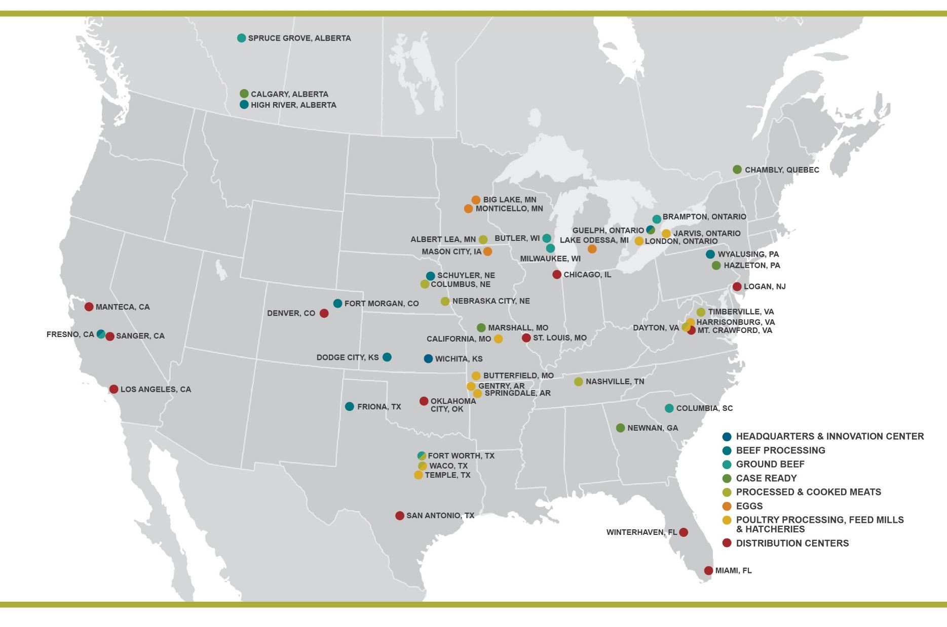
Cargill Protein Locations
Notes:
Our business employs approximately 28,000 people in about 60 locations across North America. Cargill Protein is headquartered in Wichita, Kansas and services approximately 6,000 customers.

Slide 5





















Our Brand Portfolio
TURKEY
EGGS
FRESH BEEF
PROCESSED & COOKED MEATS
BURGERS

Slide 6




Retail
Foodservice
Provide leading retailers with products and capabilities that drive growth and resonate with consumers.
Retail
Deliver value-added, protein-based meal components to foodservice customers.
Cargill Protein
Customer
Channels
Create protein solutions that are in and on your food and execute international protein sales.
We will focus on temporary incubation of new business
for leading or growing a new venture or acquisition.
Protein Ingredients
& International
Growth Ventures
& Strategic Pricing
Notes:
Briefly explain each channel, giving relevant/local examples of each (i.e. local foodservice customers, retail brand you can find locally, brand where you can find our Protein Ingredients products, etc.)
Our business employs approximately 27,000 people in 60 locations across North America. Cargill Protein is headquartered in Wichita, Kansas and services approximately 6,000 customers.
Overarching themes of our new business strategy include:
Customer-first mindset
Driven by consumer insights
Talent/team development
Retail Overview:
Retail customers will be prioritized and segmented into categories that will help our unified sales and commercial teams identify their needs and wants and define how to best serve those desires.
Strategically work with customers, such as Walmart and Kroger, to provide invaluable insights, advice and ideas to mutually grow business and become their most valued partner
Foodservice Overview:
Provides foodservice customers with value-added, protein-based meal components (cooked/formed protein, fresh or frozen processed protein, fresh or frozen whole protein)
Serves broad/diversified customer base and be a leader in providing insights, culinary-led innovation, and holistic supply chain solutions while delivering superior integrated customer experience
Protein Ingredients & International Overview:
Customers are looking for more ways Cargill can differentiate and add value for them; opportunities for us to grow
Products from this channel include protein ingredients such as pizza toppings, canned soups, frozen products and meals
Growth Ventures & Strategic Pricing Overview:
Provides channels with business strategy/choices, as well as works to identify and develop emerging customers and solutions
Area of our business where we will focus on temporary incubation of new business (i.e. pet treats) to determine best approach moving forward

Slide 7
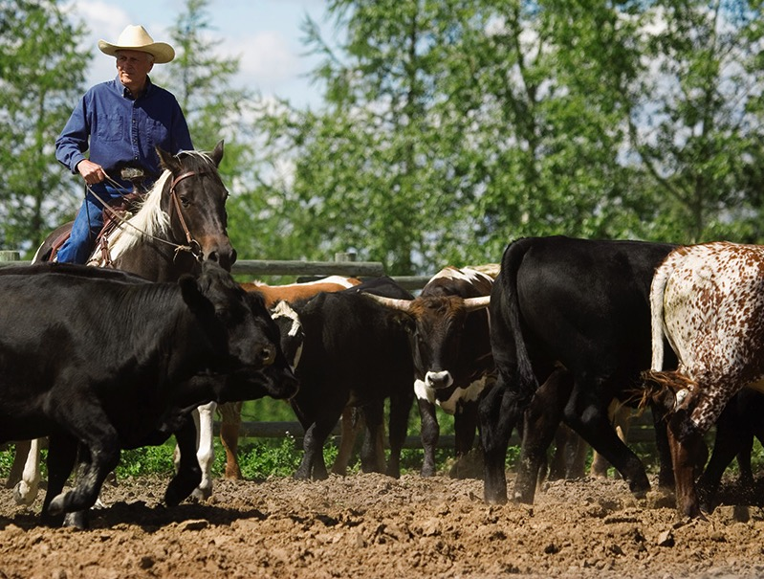
BEEF QUALITY ASSURANCE
A national program that raises consumer confidence through proper management techniques.
Our goal is 90% by 2018.
Cargill is first beef processor to establish such a meaningful target.
www.BQA.org
Notes:
Using industry best practices and programs are important tools to lead and respond to industry trends.
Beef Quality Assurance is a national program that raises consumer confidence through offering proper management techniques and a commitment to quality within every segment of the beef industry.
Managed by NCBA and provides training and certification to producers about best practices
Relevance to this discussion because of guidelines for producers on how to properly administer and use antibiotics to ensure animal health and food safety
Today more than 50% of our U.S. beef cattle supply from feed yards are BQA certified;
Our goal is 90% by 2018.
Explain how Cargill will track and report % of cattle from BQA certified sources
Cargill is working with the Canadian beef industry to adopt an equivalent standards program.

Slide 8
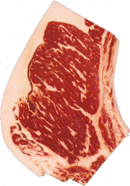
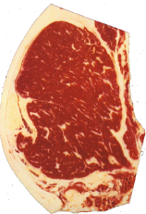
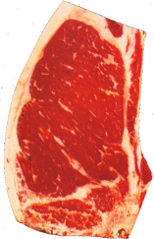
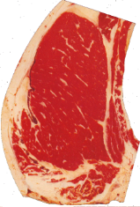
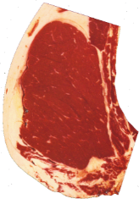
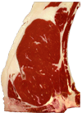
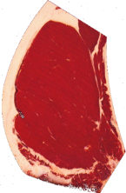



Cargill FY 2017 Beef NA Product Mix
Prime, Choice/AAA and Select/AA account for 96% of our current production—the remainder is No Roll at 4%
The depiction below represents the minimum marbling lines
Canada: Prime = 3%, AAA = 69%, AA = 27%, NR = 1%
3%
76%
17%
High Choice
Average Choice
Low Choice
Select
Prime
Moderately Abundant
Slightly Abundant
Moderate
Modest
Small 50
Small
Slight
o
71/40% Black Hided
34/33%

Slide 9
U.S. Beef and Dairy Cow Herd ('000 Head), 1980-2018

Slide 10
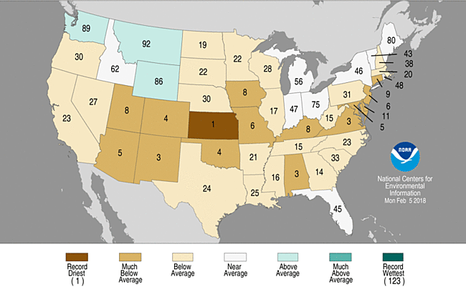
Statewide Precipitation Ranks
(Nov 2017 – Jan2018); Period: 1895-2018
Source: NOAA: NCEI
Notes:
https://gis.ncdc.noaa.gov/maps/ncei/cag
https://www.ncdc.noaa.gov/temp-and-precip/drought/weekly-palmers/

Slide 11
Futures Update: Forward Curve
February futures are now a premium to the April. LC market showing inversion into June. Feeder futures are pricing strength for spring/summer following a lighter feeder inventory to start the year. Strength in the LC Oct/Dec also supportive FC.

Slide 12
Cattle Supply Story: Placements
December placements were 101% of year ago. Following 11 months of strong placements, cattle on feed inventories began the year 8% above year ago.
Source: USDA

Slide 13
Cattle Supply Story: Feeder Availability
Feeder supply as of January 1st was below year ago levels. Very positive cattle feeding profitability and dry pasture conditions pulled more cattle into feedyards at lighter weights.
Source: USDA
Notes:
Source: CattleInventory.xlsm

Slide 14
Supply Fundamentals: Grading
Choice+ grade began the year very well. Increased heifer harvest and fewer class B & C maturity animals should be favorable to grade going forward.
Source: USDA
Notes:
Cattle\Beef\Misc\WeeklyStatsConfidential.xlsx Grade Chart

Slide 15
FI Steer and Heifer Harvest
+ 1.2 million head (+5%) 2017 vs 2016
+5% vs the 5-Year Avg
Source: USDA

Slide 16
Commercial Beef Production
+ 950 million lbs (+3.8%) 2017 vs 2016
+ 1 billion lbs (+3.9%) 2018 vs 2017
Source: USDA

Slide 17
USDA Choice Cutout
Strong beef demand has been very supportive to beef prices. Increased beef supplies have not negatively impacted the beef complex.
Notes:
Driven by a host of issues: cattle availability, choice supply, 50s trim

Slide 18
Supply Fundamentals: Imports
2017 total imports were 1% below year ago. Imports are expected to be down 5% in 2018.
Source: USDA
Notes:
BeefImports.xlsx Chart3

Slide 19
Supply Fundamentals: Exports
2017 total exports were 12% above year ago setting a new annual record. With growing international beef interest, next year should be close to 5-6% larger than 2017.
Source: USDA

Slide 20
Customer Demand Opportunities
Competition at retail from new entrants and aggressive response from existing firms
Changing format, limited assortment, low cost, improved quality, and shorter supply chains
Customers talking about e-commerce, freight increases/growing regulations, cost-stacking, labor
Case ready growth anticipated
Labor shortages in plants
Additional production capacities for milk, pork, and chicken
New phenomenon – cheap grain, increased protein demand – specialty growing over 20%
Walmart Inc Stock Price Daily Closes Nov 2015-Feb 2018

Slide 21



International Trade
2018 Export growth 3-6% baseline, likely higher
Japan and S. Korea have been the stars – domestic production down in Asia and Australia
China challenged by agreement restrictions
Demand positive, global economies growing
Watchlists:
  NAFTA – bigger risk to pork and poultry; fall back to WTO tariffs
  Impact less for beef due to more “two-way” trade, risk is collateral damage
  KORUS & TPP
29%
17%
15%

Slide 22
Recap
Expansion phase of cattle cycle nearing the end – spring moisture critical to timing
Combination of competitive forces amongst our customers and export tailwinds driving excellent wholesale beef demand which is trickling down the supply chain
Grading shifts higher and rising incomes are changing traditional competing protein relationships
Beef supply chain profitability and changing demographics both driving specialty production growth – (pasture crafted)
Trade matters more than ever with rising US as well as global beef production

