Slide 1

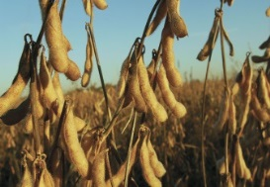

Food & Consumer Trends – The Long-Range Impact on Grains & Oilseed Sectors
NOPA Industry Forum
Prepared by Sam Funk, Ph.D.
Vice President – RaboReasearch Food & Agribusiness
Grains and Oilseeds Senior Analyst
22 February 2018
1

Slide 2

Non-Traditional Solutions

Slide 3
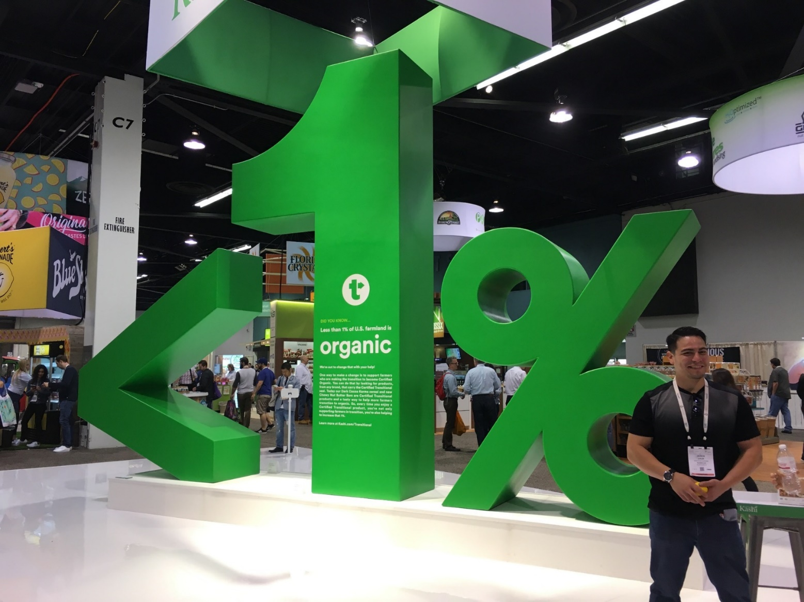
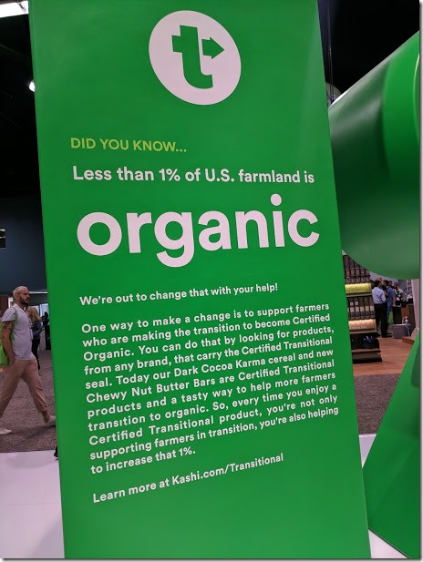

Slide 4

Strategic Starting Point

Slide 5

Strategic Positioning

Slide 6
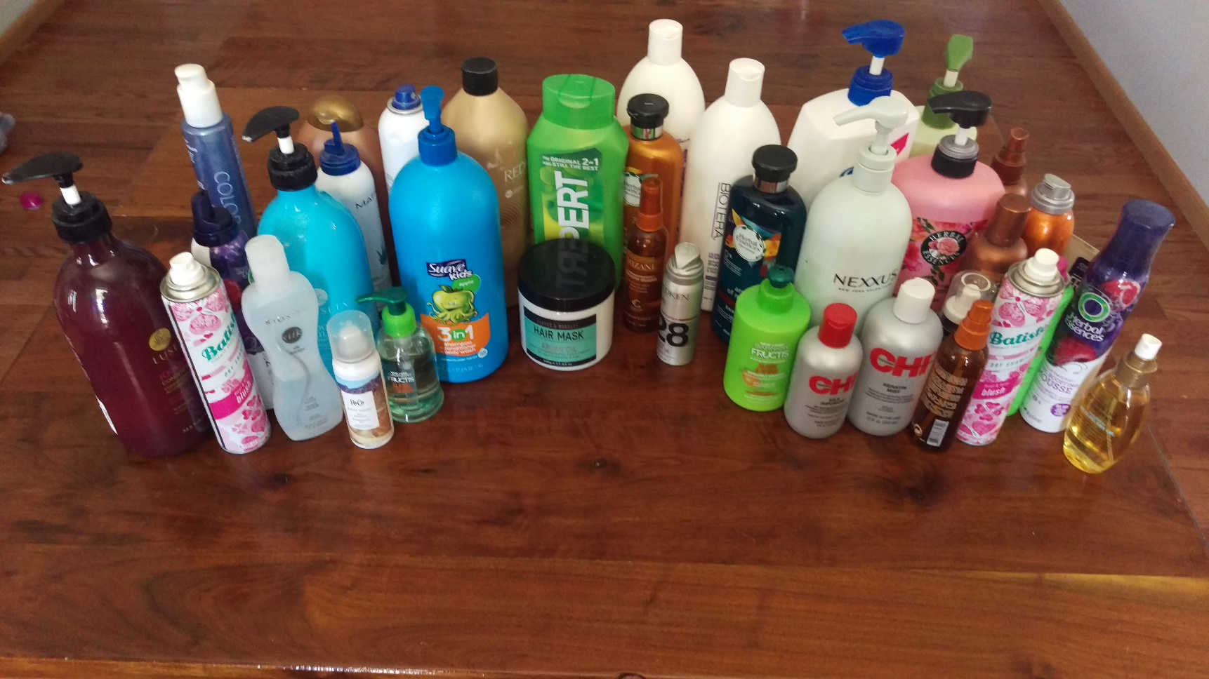
Consumer Changes

Slide 7
Strategic Relationships
Source: RaboResearch, 2017

Slide 8
Implications for Agriculture
Source: RaboResearch, 2017

Slide 9
Words Matter
Educate
Plan
Prepare.

Slide 10


Get Ready to Speak Order/Fill Language
createGenesisBlock(){

Slide 11

It’s Not Just Data

Slide 12


Slide 13
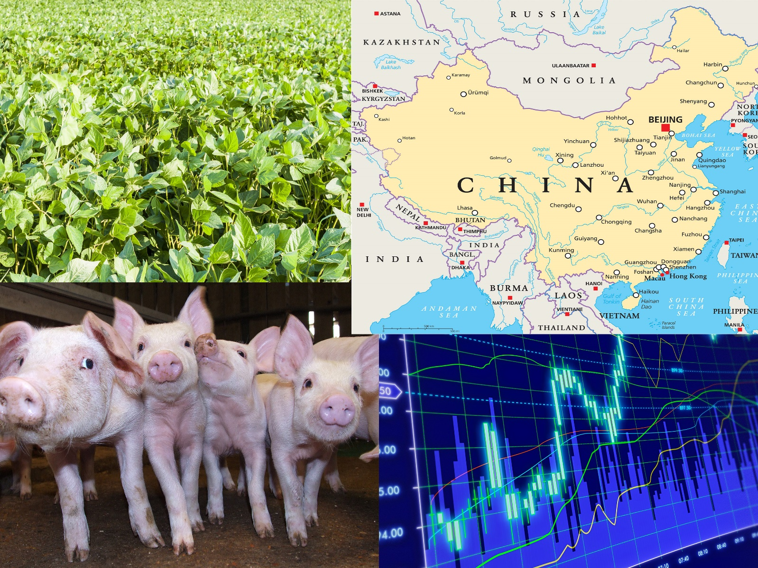

Slide 14
Keys for Strategic Position
Disrupters
Critical Mass v. Critical Application
Risk-Reward
Invest @frontier or @stretch
Master
Best Jump-Start; Best Informed
Gambler
1-800-BETS-OFF
Constraint
Accept Truth, Achieve Flexibility for Opportunity
Hybrids
Value Voices; Placement; Leading Optimization.

Slide 15

Econ 101

Slide 16
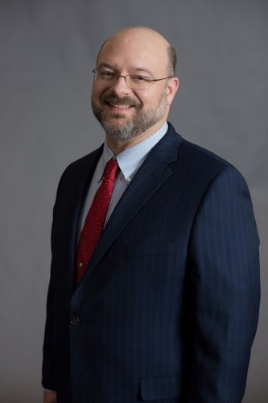
Biography and Contact Information
Sam Funk, Ph.D. is a Vice President and Senior Research Analyst within the RaboResearch Food & Agribusiness group.
Sam is responsible for managing Rabobank’s research mandate in the North American Grains & Oilseeds sector. He brings to the Bank more than 20 years of Agriculture and Agribusiness research and management of programs and organizations. Sam has provided leadership of annual investment portfolios providing research, promotion, and outreach that impacted industries and families around the world.
Prior to joining Rabobank in 2017, Sam was the CEO and Executive Economist of AgServe, LLC, an independent research and consulting firm he founded in 2002. He also served in senior executive and research roles with several leading organizations, namely the United Soybean Board, Doane Advisory Services, and Kansas State University.
Sam received his Ph.D. in Agricultural Economics from Kansas State University, Masters from Texas A&M, and Bachelors from the University of Missouri. Well known for his subject matter expertise in Grains & Oilseeds, Sam has an extensive background in animal agriculture. Having farmed full-time and served as Chair of an animal agriculture advisory committee for the Kansas Farm Bureau State, Sam has demonstrated leadership at several levels.
Providing leadership in the agricultural economics profession, Sam has been on the executive team of multiple subject matter Sections within the Agricultural & Applied Economics Association (AAEA). He currently serves as the Chair of the Extension Section of the AAEA and on the AAEA Trust Committee. Sam also served on the inaugural Blue Ribbon Expert Panel on Global Competitiveness and Profitability of Agriculture with the Council on Food, Agricultural & Resource Economics (C-FARE).
Contact Information:
Sam Funk, Ph.D.
Rabo AgriFinance
14767 N. Outer 40 Rd., Suite 400
Chesterfield, Missouri 63017
Telephone: (314) 471-2601
Email: Sam.Funk@Raboag.com

Slide 17

Banking & Securities Disclosure
This document has been prepared exclusively for your benefit and does not carry any right of publication or disclosure other than to Coöperatieve Rabobank U.A. (“Rabobank”), registered in Amsterdam. Neither this document nor any of its contents may be distributed, reproduced or used for any other purpose without the prior written consent of Rabobank. The information in this document reflects prevailing market conditions and our judgement as of this date, all of which may be subject to change. This document is based on public information. The information and opinions contained in this document have been compiled or derived from sources believed to be reliable, without independent verification. The information and opinions contained in this document are indicative and for discussion purposes only. No rights may be derived from any potential offers, transactions, commercial ideas et cetera contained in this document. This document does not constitute an offer or invitation. This document shall not form the basis of or cannot be relied upon in connection with any contract or commitment whatsoever. The information in this document is not intended and may not be understood as an advice (including without limitation an advice within the meaning of article 1:1 and article 4:23 of the Dutch Financial Supervision Act). This document is governed by Dutch law. The competent court in Amsterdam, The Netherlands has exclusive jurisdiction to settle any dispute which may arise out of or in connection with this document and/or any discussions or negotiations based on it. This report has been published in line with Rabobank’s long-term commitment to international food and agribusiness. It is one of a series of publications undertaken by the global department of Food & Agribusiness Research and Advisory.
©2016 - All Rights Reserved.

