Slide 1
Overview & Assessment of U.S. Soybean Processing Industry 13th S.E. Asia Agricultural Cooperators Conference
Thomas Hammer, President National Oilseed Processors Association Cebu, Philippines
August 1, 2016

Slide 2
NOPA Members
12 NOPA member companies
Account for 96% of US soybean crush
Operate 63 processing plants in 19 states, including 57 that process soybeans
Crush 1.8 billion bushels, comprising over 46% of U.S. soybean farmers’ production in 2014/15

Slide 3
NOPA Membership
Ag Processing Inc.
Archer Daniels Midland Company
Bunge North America
Cargill, Incorporated
CHS
Consolidated Grain and Barge Company
Incobrasa Industries, Ltd.
Louis Dreyfus Commodities
Owensboro Grain Company
Perdue Grain & Oilseed, LLC
Riceland Foods, Inc.
Zeeland Farm Soya

Slide 4
NOPA’s Members Produce: Food, Feed & Fuel
Soybean Meal:
97% used to feed poultry & livestock
3% used in food products like protein alternatives & soy milk
Soybean Oil:
68% used for frying and baking food, as a vegetable oil & as an ingredient if foods like salad dressings & margarines
25% used for biodiesel and bioheat
7% is converted into industrial used like paints, plastics and cleaners
Source: United Soybean Board

Slide 5
NOPA’s Vision…
“NOPA favors a market-based trading environment that encourages the efficient production of an abundant, safe, sustainable and high-quality supply of oilseeds and oilseeds products for domestic and world consumers of food, feed-ingredients and renewable fuels.”

Slide 6
Critical Industry Challenges in a Tough Economy
Promote Healthy Crushing Industry
“Tough but Fair” Regulations
Fair & Open Trading System
Maintain/Expand Markets for Soybean Products
“Responsible Use” of Biotechnology
Promote Healthy Livestock Industry
User-Friendly Operating Environment
Expand Domestic & International Markets
Promote Healthy Oilseed Producer Industry
Market-Oriented Farm Programs
Risk Management & Insurance Programs
Adequate Funds for Research & Market Development

Slide 7
Many Difficult Issues Facing our Industry over Next Several Years
U.S. animal agriculture faces significant challenges
Water & Air pollution issues from livestock manure
Animal welfare issues related to certain management practices
Animal identification & traceability systems – disease & biosecurity
Legal uncertainty with immigration & farm labor issues
Perhaps, the biggest challenge facing animal agriculture will be to meet the increased food needs of a growing global population.
Federal over-regulation of U.S. Manufacturing Industries
Cost of all federal government regulations, including: Economic, Environmental, Food & Drug, Tax Compliance & Occupational Safety, Health & Homeland Security regulations) cost U.S. Manufacturers an estimated $2.028 trillion in 2012 -12% of U.S. GNP, or just less than $10,000 per employee per year.
Many federal regulations should be subjected to a “benefit-cost” analysis to ensure that they are both “fair & reasonable”.

Slide 8
Many Difficult Challenges Facing our Industry over Next Several Years (cont.)
Demagoguery on “International Trade” by Politicians & Pundits
Intellectual consensus does exist for mutually-beneficial free trade.
But, all final 2016 presidential candidates, including Donald Trump, Hillary Clinton & Bernie Sanders have made global trade a “lightening rod.”
While many politicians rail against unfair trade agreements & unlevel-playing fields on the “election stump” – they do change their tune after taking the Presidential oath - every President since Franklin Roosevelt, regardless of political party, has embraced and even promoted trade liberalization.
Absence of science-based conversations on agricultural biotechnology by the vocal minority of opponents.
Must confront the lack of intellectual honesty over foods containing GMOs.
A very strong messages can be delivered about food biotech.
Over last 15 years, not one concern about food safety, environmental impact or the lack of either sound science and rigorous regulations can be substantiated.
Biotech is key to ensuring a safe & abundant food supply to meet the needs of the world’s growing population.

Slide 9
NOPA Members – Monthly Crush Statistics
Soybean Crush –CY2012-16
Soybean Meal Exports
-CY2012-16

Slide 10
NOPA Soybean Crush CY2012-2015 (000Bu.)

Slide 11
NOPA Soybean Meal Exports CY2011- 2016 (tons)

Slide 12
U.S. Soybean Meal: Crush & Disappearance (1,000 short tons)
Source: USDA, World Agricultural Outlook Board – July 6,2016

Slide 13
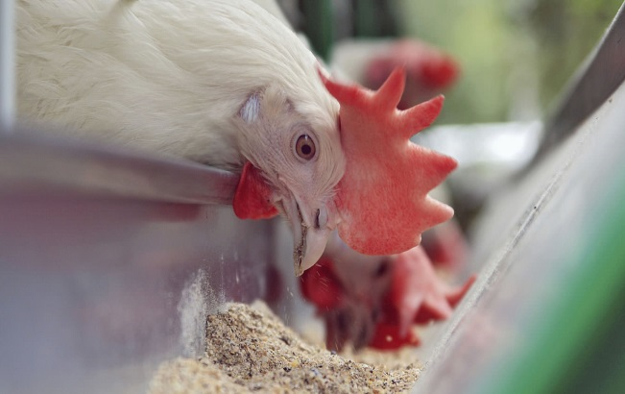
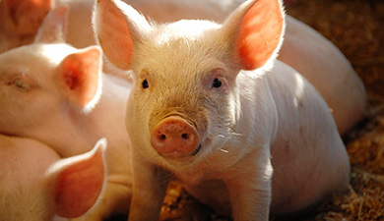
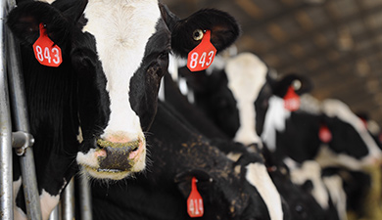
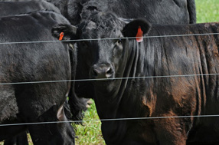
U.S. Animals Consumed over 30 Million M/T of
Soybean Meal in 2015

Slide 14
U.S. Soymeal Usage by Livestock (FY2015)
POULTRY | 16.3 Million Metric Tons
SWINE | 6.9 Million Metric Tons
BEEF | 3.5 Million Metric Tons
DAIRY | 2.1 Million Metric Tons
PET FOOD | 0.6 Million Metric Ton
OTHER FEED | 0.67 Million Metric Tons
TOTAL | 30.2 Million Metric Tons
Source: Based on industry estimates, USB 2008 soymeal market study, USDA (NASS)

Slide 15
U.S. Meat & Poultry Exports (2004/05 – 2026/27 est.)
Source: USB, October 2015

Slide 16
U.S. Soybean Meal Exported in Meat (2004/05 – 2026/27 est.)
Source: USB, October 2015

Slide 17
U.S Soybean Oil Production (2000-2015)
Source: WSDA, WAOB

Slide 18
U.S. Soybean Oil Exports 2000/01 –2014/15 and Forecast for 2015/16 and 2016/17

Slide 19
U.S. Soybean Oil: Production & Disappearance (Million pounds)
Source: USDA, World Agricultural Outlook Board – July 6, 2016

Slide 20
U.S. Vegetable Oil Consumption (2015)
Feedstock | Million M/T
Soybean | 8.9
Rapeseed/Canola | 2.2
Corn | 1.7
Palm | 1.2
Coconut | 0.5
Other* | 1.3
Total | 15.7
*Other includes: palm kernel, peanut, sunflower, safflower and others
Source: ERS, USDA

Slide 21
Exploding World Population – very good for Global Protein Industry

Slide 22
Emerging Middle Class will be “Engine Room” for Future Global Development
Middle classes are rapidly expanding in emerging & developing countries.
In richer countries, the middle class is shrinking & feels incapable of defending the standard of living that it has enjoyed for centuries.
Today, both of these middle classes are awakening!
Key question for the future: Which middle class will become the real “agents of change”?
Source: OECD Development Center

Slide 23
World Population Centers Changing – will provide new market opportunities

Slide 24
Why is Precision Agriculture Important?
The world’s population is expected to grow -- while the ratio of arable land continues to decrease.
The UN’s FAO predicts global food production must double, and 70 % of world’s additional food needs can be produced only with new and adapting agricultural technologies.
Precision Agriculture, or “as needed” farming fits well with Hugh Hammond Bennett’s* admonition to “… use every acre within its capability and treat it according to its needs.”
The U.S. soy value-chain is commitment to innovation, stewardship, and to meeting the global food challenges - in a safe & highly stainable manner -- now and into the future!
*Bennett was a pioneer in field of soil conservation & founded the U.S. Soil Conservation Service.

Slide 25
S.E. Asia is Excellent Market for U.S.
As a block, it is the 2nd fastest growing economy in Asia after China - expanding by 300% since 2001 & exceeding the global growth average for the past 10 years.
S.E. Asia's growing middle class, purchasing power & close trade ties - all point to greater U.S. -S.E. Asia benefits over time.
Source: US-ASEAN Business Council

Slide 26
S.E. Asia is 3rd Largest Economy in Asia & the World’s 7th Largest
Has a growing consumer base of 626 million
Has a combined GDP of $2.4 trillion
Source: US-ASEAN Business Council

Slide 27
U.S. Agriculture Exports to S.E. Asia - Up Sharply in Recent Years

Slide 28
S.E. Asia Markets for U.S. Soymeal (MY2009/09-2014/15 – M/T)
Soymeal | 2008/09 | 2009/10 | 2010/11 | 2011/12 | 2012/13 | 2013/14 | 2014/15
Cambodia | 0 | 0 | 919 | 5,421 | 5,615 | 1,977 | 13,754
Indonesia | 141,820 | 528,871 | 29,313 | 109,274 | 91,388 | 53,172 | 100,381
Malaysia | 22,002 | 123,786 | 21,565 | 15,184 | 14,045 | 20,307 | 1,595
Philippines | 493,350 | 957,514 | 863,033 | 1,159,491 | 1,085,222 | 1,258,255 | 1,418,139
Singapore | 24 | 368 | 877 | 1,473 | 1,168 | 1,085 | 803
Thailand | 116,639 | 203,937 | 11,949 | 28,314 | 29,649 | 379,703 | 724,786
Vietnam | 126,004 | 474,442 | 36,828 | 66,725 | 275,039 | 350,371 | 449,952
Total | 899,839 | 2,288,918 | 963,607 | 1,385,882 | 1,502,126 | 2,064,870 | 2,709,410
Source: U.S. Census Bureau

Slide 29
Top Ten Reasons to Buy U.S. Soy
Nutritional Value Proposition
Availability of Supply
Reliability of Product
Hedgeability
Transportation Diversity
Consistency of Product
Quality/Claims Process
Sustainable Production
Market-Driven Policies
US Soybean Industry Support

Slide 30
Sustainability = Opportunity
Do the right thing: This is closely aligned with NOPA’s Vision Statement.
Become the supplier of first choice: Our domestic and foreign customers and their consumers are increasingly concerned about sustainability. Our members must aim to become “the most trusted suppliers of sustainable soybean products.”
Grow our global business: The growing importance of sustainability gives us opportunities to innovate, rethink how we do business & grow our business for soy and soy-based products in new directions.

Slide 31
U.S. Soy Processors work hard to protect & promote our global supply chains!
U.S. soybeans, meal & oil are the most sustainable in the world.
U.S. laws & regulations governing farmers, grain handlers, processors & exporters are the most rigorous in the world.
US soy & soy products are the best overall value for our global customers.

Slide 32
Questions or Comments…

Slide 33
Contact Information:
National Oilseed Processors Association
1300 L Street, NW
Suite 1020
Washington, DC 20005
USA
Phone: 202.842.0463
Website: www.nopa.org

