Slide 1
Overview & Assessment of U.S. Soybean Processing Industry China Oils & Oilseeds Summit
Thomas Hammer, President National Oilseed Processors Association Chengdu, China
July 14 - 15, 2016

Slide 2
NOPA Members
12 NOPA member companies
Account for 96% of US soybean crush
Operate 63 processing plants in 19 states, including 57 that process soybeans
Crush 1.8 billion bushels, comprising over 46% of U.S. soybean farmers’ production in 2014/15

Slide 3
NOPA Membership
Ag Processing Inc.
Archer Daniels Midland Company
Bunge North America
Cargill, Incorporated
CHS
Consolidated Grain and Barge Company
Incobrasa Industries, Ltd.
Louis Dreyfus Commodities
Owensboro Grain Company
Perdue Grain & Oilseed, LLC
Riceland Foods, Inc.
Zeeland Farm Soya

Slide 4
NOPA’s Members Produce: Food, Feed & Fuel
Soybean Meal:
97% used to feed poultry & livestock
3% used in food products like protein alternatives & soy milk
Soybean Oil:
68% used for frying and baking food, as a vegetable oil & as an ingredient if foods like salad dressings & margarines
25% used for biodiesel and bioheat
7% is converted into industrial used like paints, plastics and cleaners
Source: United Soybean Board

Slide 5
NOPA’s Vision…
“NOPA favors a market-based trading environment that encourages the efficient production of an abundant, safe, sustainable and high-quality supply of oilseeds and oilseeds products for domestic and world consumers of food, feed-ingredients and renewable fuels.”

Slide 6
NOPA Members – Monthly Crush Statistics
Soybean Crush –CY2012-16
Soybean Meal Exports
-CY2012-16

Slide 7
NOPA Soybean Crush CY2012-2015 (000Bu.)

Slide 8
NOPA Soybean Meal Exports CY2011- 2016 (tons)

Slide 9
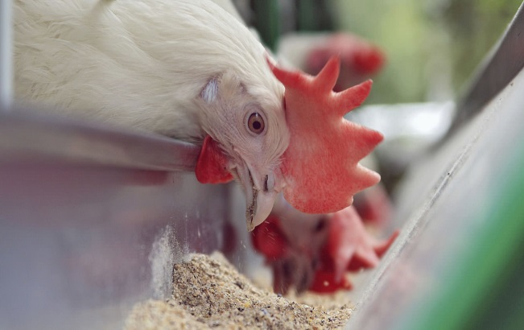
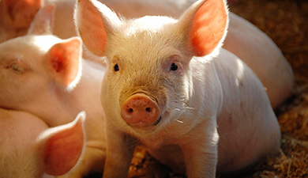
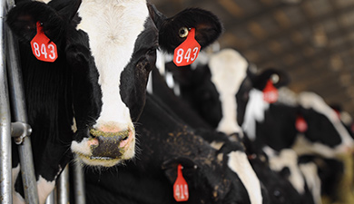
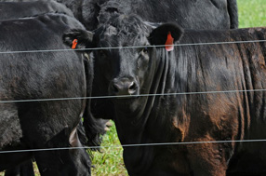
U.S. Animals Consumed over 30 Million M/T of
Soybean Meal in 2015

Slide 10
U.S. Soymeal Usage by Livestock (FY2015)
POULTRY | 16.3 Million Metric Tons
SWINE | 6.9 Million Metric Tons
BEEF | 3.5 Million Metric Tons
DAIRY | 2.1 Million Metric Tons
PET FOOD | 0.6 Million Metric Ton
OTHER FEED | 0.67 Million Metric Tons
TOTAL | 30.2 Million Metric Tons
Source: Based on industry estimates, USB 2008 soymeal market study, USDA (NASS)

Slide 11
U.S. Soymeal: Crush & Disappearance (1,000 short tons)
Source: USDA, World Agricultural Outlook Board – July 6,2016

Slide 12
U.S. Vegetable Oil Consumption (FY2015)
Feedstock | Million M/T
Soybean | 8.9
Rapeseed/Canola | 2.2
Corn | 1.7
Palm | 1.2
Coconut | 0.5
Other* | 1.3
Total | 15.7
*Other includes: palm kernel, peanut, sunflower, safflower and others
Source: ERS, USDA

Slide 13
U.S. Soybean Oil: Production & Disappearance (Million pounds)
Source: USDA, World Agricultural Outlook Board – July 6, 2016

Slide 14
U.S. Soyoil Exports to China (MY2009/10 -2014/15)
MY2015/16: Outstanding Export Sales

Slide 15
China’s Feed Industry & its Demand for Imported Soybeans has Consequences on Global Agricultural Markets

Slide 16
China’s Soymeal Consumption (1971/72 – 2014/15 and USDA Forecast for 2015/16 and 2016/17)

Slide 17
World’s Largest Soymeal Consumers (Forecast for 2015/16 Marketing Year)

Slide 18
Soybean Imports by China and Rest of World (1995/96 – 2014/15 and USDA Forecast for 2015/16 and 2016/17)

Slide 19
World’s Largest Soybean Importers (Forecast for 2015/16 Marketing Year)
e

Slide 20
Exploding World Population – very good for Global Protein Industry

Slide 21
World Population Growth will Equal Two More Chinas – by 2050!

Slide 22
Global Soybean Consumption (2000/01 – 2016/17 and Trend to 2026/27)
If trend continues the World will need another 80 MMT soybeans in a decade!

Slide 23
World needs another production area equal to Argentina, Paraguay, Uruguay & Bolivia in 10 Years
Soybean Production -2014/15 (act.) | MMT
Argentina | 61.4
Paraguay | 8.1
Uruguay | 3.1
Bolivia | 2.6
Total Production | 75.2

Slide 24
Why is Precision Agriculture Important?
The world’s population is expected to grow -- while the ratio of arable land continues to decrease.
The UN’s FAO predicts global food production must double, and 70 % of world’s additional food needs can be produced only with new and adapting agricultural technologies.
Precision Agriculture, or “as needed” farming fits well with Hugh Hammond Bennett’s* admonition to “… use every acre within its capability and treat it according to its needs.”
The U.S. soy value-chain is commitment to innovation, stewardship, and to meeting the global food challenges - in a safe & highly stainable manner -- now and into the future!
Bennett was a pioneer in field of soil conservation & founded the U.S. Soil Conservation Service.

Slide 25
Smart Farming = Sustainable Intensification
Ensure that safe and abundant food/feed can be produced on a finite amount of farmland to meet the needs of the world’s growing population.
Develop/utilize proper tools to minimize agricultural inputs, soil erosion, energy & water usage, greenhouse gas emissions, etc.
Embrace food/feed technology focusing on safety, consumer benefits, sustainability and feeding the world.
Increase production yields by leveraging technology, using best farming practices, and by “managing” nature.
Goal of “Smart Farming” is to optimize processes and uses of resources and efficient use of existing arable land.

Slide 26
NOPA Advocates for Healthy Supply Chain
NOPA Promotes Healthy Crushing Industry
“Tough but Fair” Regulations
Fair & Open Trading System
Maintain/Expand Markets for Soybean Products
“Responsible Use” of Biotechnology
NOPA Promotes Healthy Livestock Industry
User-Friendly Operating Environment
Expand Domestic & International Markets
NOPA Promotes Healthy Oilseed Producer Industry
Market-Oriented Farm Programs
Risk Management & Insurance Programs
Adequate Funds for Research & Market Development
Freedom to Operate – using best management practices

Slide 27
Many Difficult Issues Facing our Industry over Next Several Years
U.S. animal agriculture faces significant challenges:
Water & Air pollution issues from livestock manure
Animal welfare issues related to certain management practices
Animal identification & traceability systems – disease & biosecurity
Legal uncertainty with immigration & farm labor issues
Perhaps, the biggest challenge facing animal agriculture will be to meet the increased food needs of a growing global population.
Federal over-regulation of U.S. Manufacturing Industries:
Cost of all federal government regulations, including: Economic, Environmental, Food & Drug, Tax Compliance & Occupational Safety, Health & Homeland Security regulations cost U.S. Manufacturers an estimated $2.028 trillion in 2012 -12% of U.S. GNP, or just less than $10,000 per employee per year.
Many federal regulations should be subjected to a “benefit-cost” analysis to ensure that they are both “fair & reasonable”.

Slide 28
Many Difficult Challenges Facing our Industry over Next Several Years (cont.)
Demagoguery on “International Trade” by Politicians & Pundits:
Intellectual consensus does exist for mutually-beneficial free trade.
But, all final 2016 presidential candidates, including Donald Trump, Hillary Clinton & Bernie Sanders have made global trade a “lightening rod.”
While many politicians rail against unfair trade agreements & unlevel-playing fields on the “election stump” – they do change their tune after taking the Presidential oath - every President since Franklin Roosevelt, regardless of political party, has embraced and even promoted trade liberalization.
Absence of science-based conversations on agricultural biotechnology by the vocal minority of opponents:
Must confront the lack of intellectual honesty over foods containing GMOs.
A very strong messages can be delivered about food biotech.
Over last 15 years, not one concern about food safety, environmental impact or the lack of either sound science and rigorous regulations can be substantiated.
Biotech is key to ensuring a safe & abundant food supply to meet the needs of the world’s growing population.

Slide 29
Top Ten Reasons to Buy U.S. Soy
Nutritional Value Proposition
Availability of Supply
Reliability of Product
Hedgeability
Transportation Diversity
Consistency of Product
Quality/Claims Process
Sustainable Production
Market-Driven Policies
US Soybean Industry Support

Slide 30
Sustainability = Opportunity
Do the right thing: This is closely aligned with NOPA’s Vision Statement.
Become the supplier of first choice: Our domestic and foreign customers and their consumers are increasingly concerned about sustainability. Our members must aim to become “the most trusted suppliers of sustainable soybean products.”
Grow our global business: The growing importance of sustainability gives us opportunities to innovate, rethink how we do business & grow our business for soy and soy-based products in new directions.

Slide 31
China will need to Import even more Soybean in Coming Decades
China’s imported vegetable oils & oilseeds already utilize over 50 million hectares to land overseas.*
China will continue to see a steep decline in the amount of arable land per person.
According to World Bank, in 1961, China had 0.16 hectares of arable land per person. In 2013, it had dropped to 0.08.
U.S. had 0.98 hectares per person in 1961. In 2013, it had dropped to 0.48 – but still has 6 times the amount of arable land per person – compared to China.
China’s ever-increasing imports of soybeans ease the burden on its severe cropland shortage
* Source: Development Research Center of China’s State Council

Slide 32
Expansion of U.S. Agricultural Trade with China has not come without Challenges
While Chinese officials view agricultural imports as necessary and have endorsed a decisive role for the global market, at times it appears that they distrust international markets.
Nonetheless, international markets have been remarkably flexible and responsive to China’s changing demands for agricultural imports.
On occasion, U.S. exports have been limited by Chinese policies that promote agricultural self-sufficiency and/or protect domestic industries.
Additionally, China’s lack of regulatory transparency and its inconsistent biotech product review and approval process tends to distort trade and create uncertainty.

Slide 33
Expansion of U.S. Agricultural Trade with China has not come without Challenges (cont.)
Nevertheless, ample opportunities for trade expansion continue to exist within China’s food & agriculture markets.
The sheer size of our mutually-beneficial trade relationship, as well as U.S agricultural exports’ support for China’s Food Security through fair & open trade – provides enormous incentives for both sides to address any and all “trade irritants.”
As major beneficiaries of China’s growing need for imports, U.S. soybean growers, processors and exporters have a keen interest to fully engaged with our Chinese partners to avoid any unwarranted restrictions and/or disruptions to this essential global supply chain for vegetable oil & oilseeds.

Slide 34
U.S. Soy Processors Work Hard to Protect & Promote our Global Supply Chains!
U.S. soybeans, meal & oil are the most sustainable in the world.
U.S. laws & regulations governing farmers, grain handlers, processors & exporters are the most rigorous in the world.
US soybeans & soy products are the best overall value for our global customers.

Slide 35
Questions or Comments…

Slide 36
Contact Information:
National Oilseed Processors Association
1300 L Street, NW
Suite 1020
Washington, DC 20005
USA
Phone: 202.842.0463
Website: www.nopa.org

